Slide 1
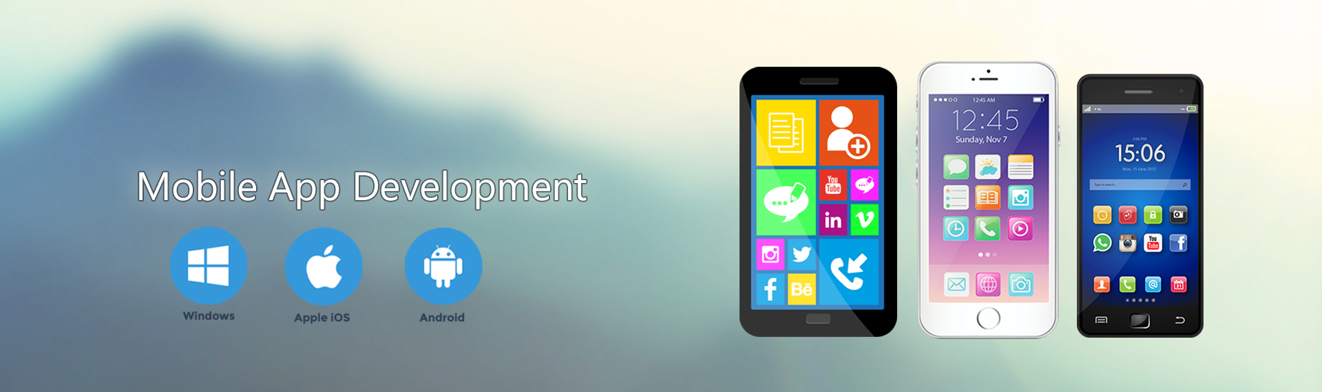

Slide 2
Lecture 1. Android Overview
What is Android?
Why Android?
What are the Features of Android?
What About Android Applications?
What is History of Android?
What is API level?

Slide 3
What is Android?
Android is an open source and Linux-based Operating System for mobile devices such as smart phones and tablet computers.
Android was developed by the Open Handset Alliance, led by Google, and other companies.
The first beta version of the Android Software Development Kit (SDK) was released by Google in 2007 where as the first commercial version, Android 1.0, was released in September 2008.
Current latest version is Android 7.1 Nougat.

Slide 4
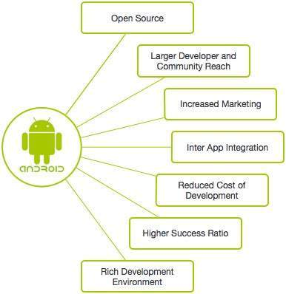
Why Android?

Slide 5
Features of Android
Feature | Description
Beautiful UI | Android OS basic screen provides a beautiful user interface.
Connectivity | Bluetooth, NFC (Near Field Communication) , Wi-Fi, USB, SIP (Session Initiation Protocol) and other network connections.
Storage | SQLite, a lightweight relational database, is used for data storage purposes.
Media support | Audio: AMR-NB/AMR-WB (.3gp), MP3(.mp3), MIDI(.mid), Vorbis(.mkv), FLAC(.flac), AAC(.aac) etc. Video: H.263(.3gp, .mp4), H.264 AVC (.3gp, .mp4, .ts), H.265 HEVC(.mp4), VP8(.webm, .mkv), VP9(.webm, .mkv) etc. Image: JPEG, GIF, PNG, BMP, WebP etc.
Messaging | SMS and MMS
Web browser | Based on the open-source WebKit layout engine, coupled with JavaScript engine supporting HTML5 and CSS3.
Multi-touch | Android has native support for multi-touch which was initially made available in handsets such as the HTC.

Slide 6
Features of Android
Feature | Description
Multi-tasking | User can jump from one task to another and same time various application can run simultaneously.
Resizable widgets | Widgets are resizable, so users can expand them to show more content or shrink them to save space
Multi-Language | Supports single direction and bi-directional text.
Wi-Fi Direct | A technology that lets apps discover and pair directly, over a high-bandwidth peer-to-peer connection.

Slide 7
About Android Applications
Android applications are usually developed in the Java language using the Android Software Development Kit.
Once developed, Android applications can be packaged easily and sold out either through a store such as Google Play Store, Opera Mobile Store, and the Amazon Appstore.
Android powers hundreds of millions of mobile devices in more than 190 countries around the world. It's the largest installed base of any mobile platform and growing fast. Every day more than 1 million new Android devices are activated worldwide.

Slide 8
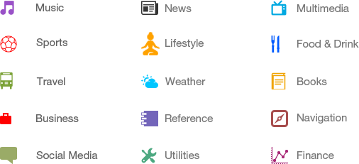
Categories of Android applications

Slide 9
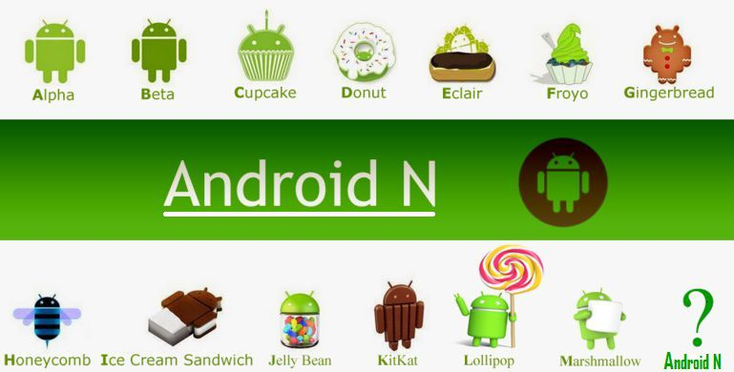
History of Android

Slide 10
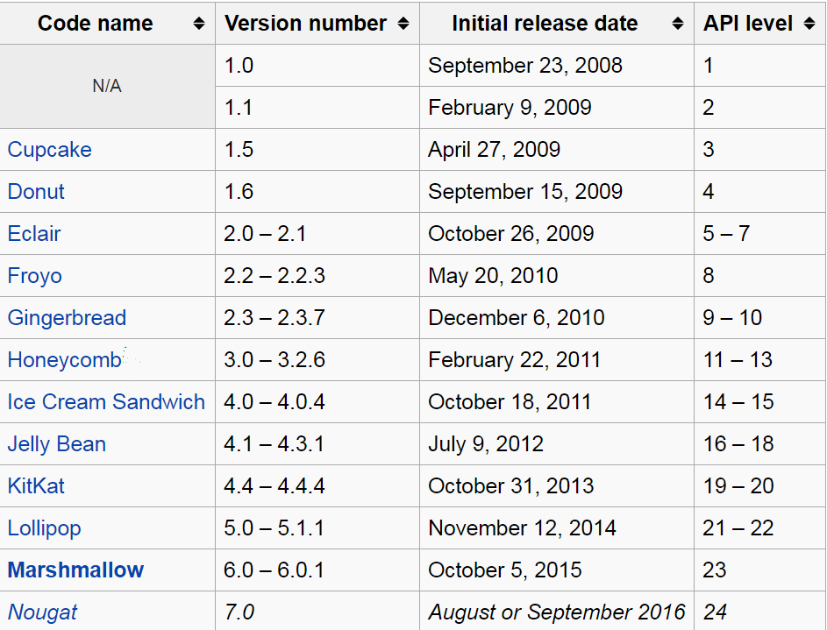
What is API level?
API (Application Programming Interface) Level is an integer value that uniquely identifies the framework.

